Slide 1
Lect1: Introduction to Artificial Intelligence
Instructor : Eng. January
Area of Research Interest: Data Science, Artificial Intelligence, Internet of Things and Embedded systems

Slide 2
Presentation Agenda
AI-Prerequisite
AI-Course Structure
Demand for AI
What is Artificial Intelligence
History of AI
AI-Applications

Slide 3
AI-Prerequisite
You need to have some understanding of maths – statistics, probability, linear algebra, and calculus.
Programming skills.
Willingness to study and learn more in depth.
Passion for, data analysis and AI learning concepts

Slide 4
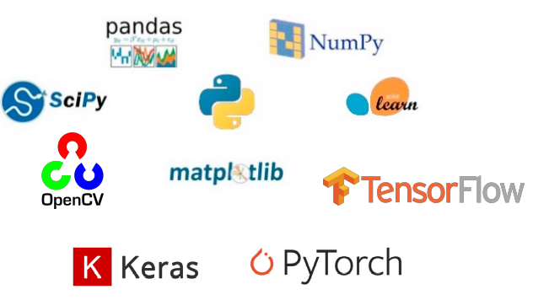
AI-Course Structure
Lecture will cover topics:
Python programming fundamentals
Python for data science
Machine Learning
Image processing
Deep Learning
Advanced topics in AI

Slide 5
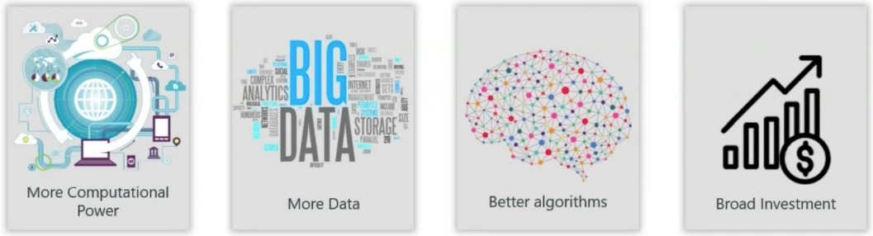
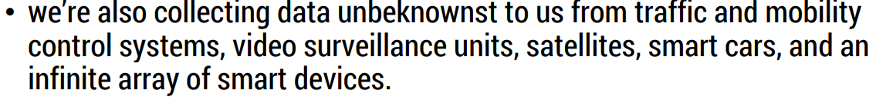
Demands for AI

Slide 6
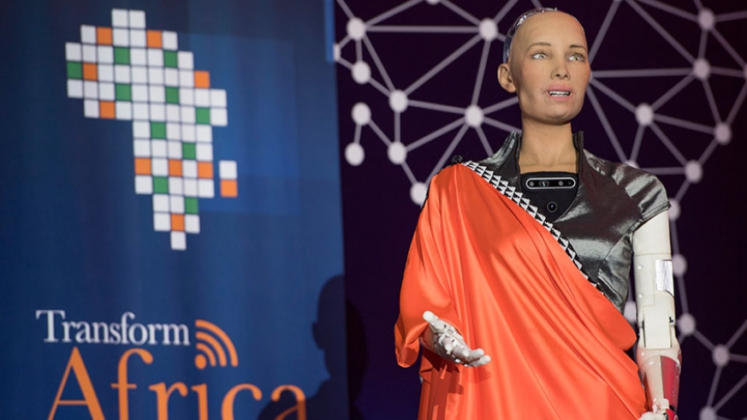

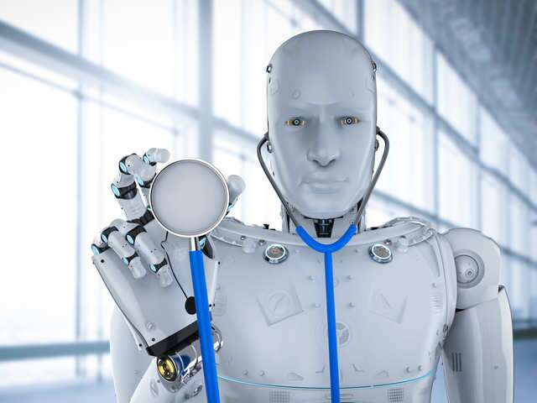

What is AI

Slide 7
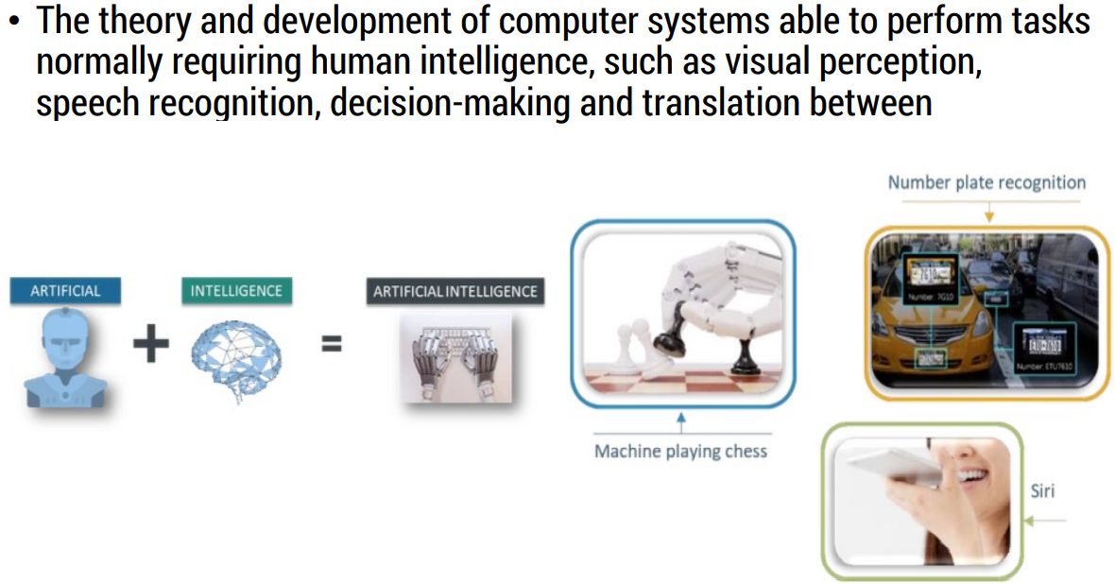
WHAT IS Artificial Intelligence?

Slide 8
HISTORY OF AI
In 1950, Alan Turing test. This test is basically used to determine whether or not a computer can think intelligently like a Human being.
In 1956, the term artificial intelligence was defined by John McCarthy at the Dartmounth Conference.
In 1959: The first AI laboratory was established by MIT. This period marked the research era for AI.
In 1997: IBM's Deep Blue beats the world champion, Garry, in the game of chess.
In 2011, IBM's question answering system, Watson, defeated the two greatest Jeopardy champions, Brad Rutter and Ken Jennings.
So, this is how AI started . So since the beginning of AI in the 1950s, we have seen an exponential growth and its potential.

Slide 9
TYPES OF AI
Artificial Narrow Intelligence: refers to a computer’s ability to perform a single task extremely well, such as crawling a webpage or playing chess.
Artificial General Intelligence: is when a computer program can perform any intellectual task that a human could.
Artificial super intelligence: is an AI that surpasses human intelligence in all activities

Slide 10
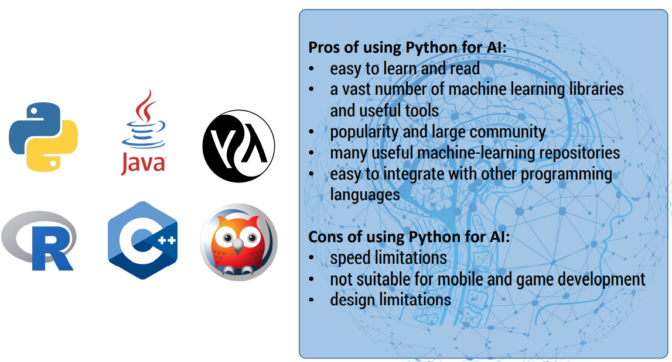
Popular languages for AI

Slide 11
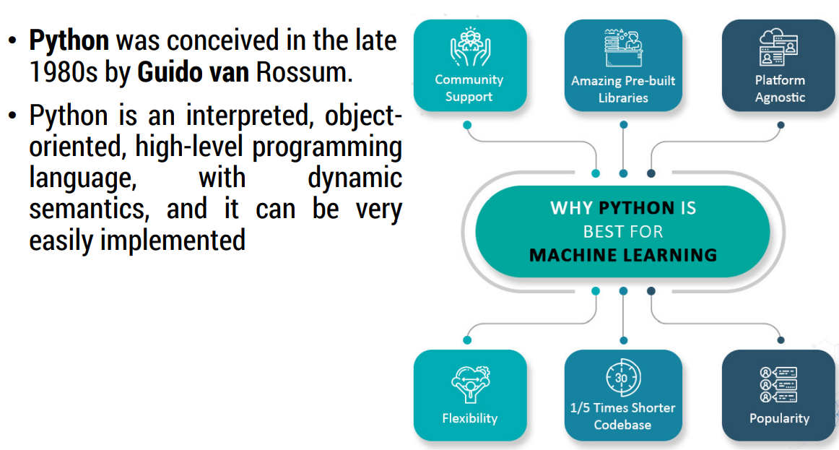
Why Python?

Slide 12
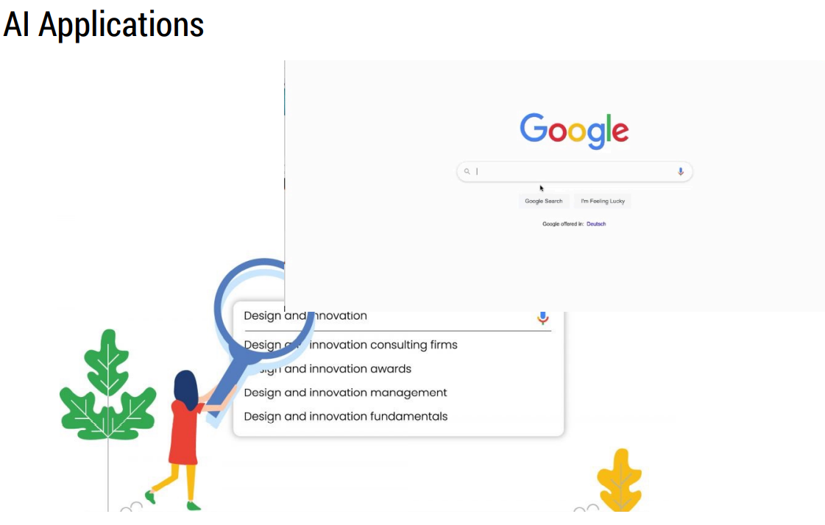

Slide 13
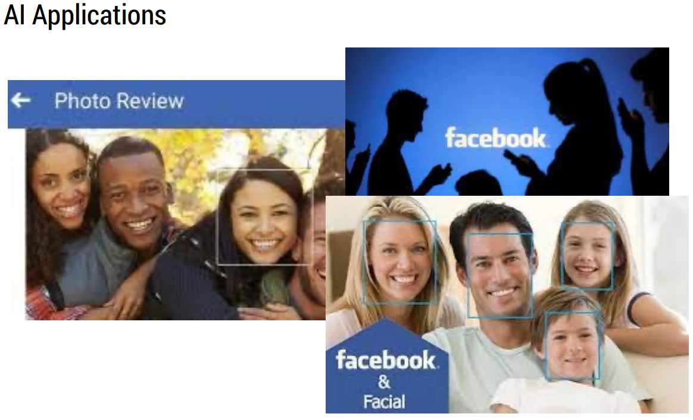

Slide 14
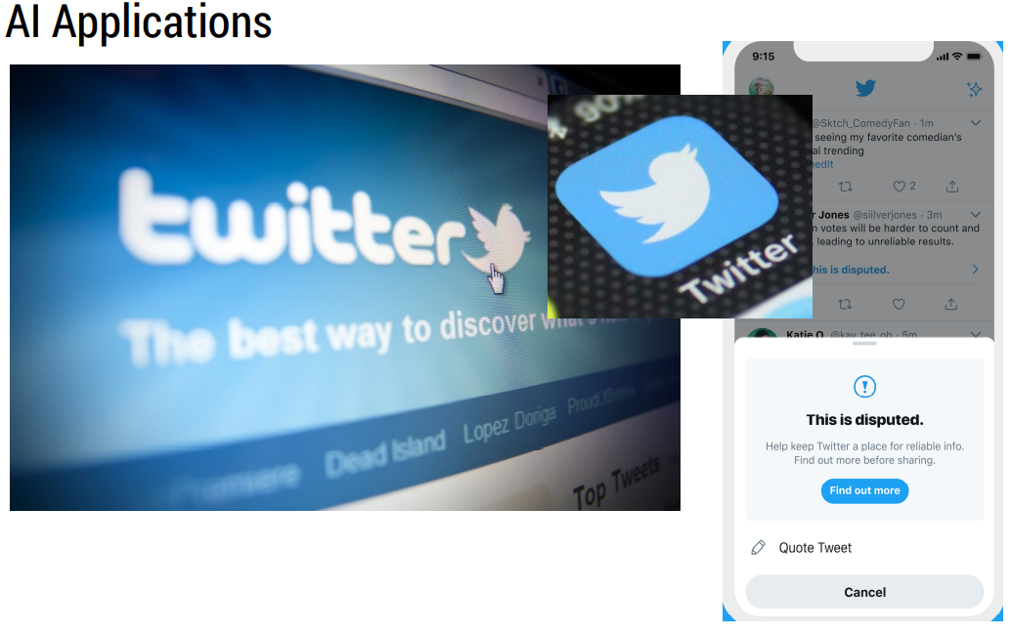

Slide 15
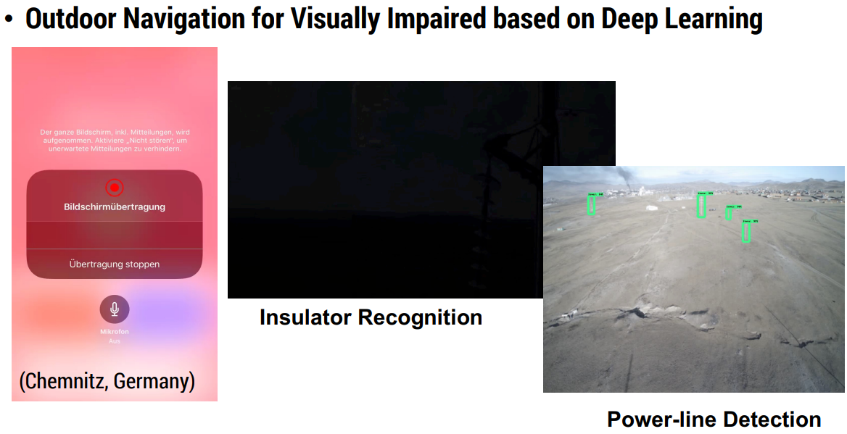

Slide 16
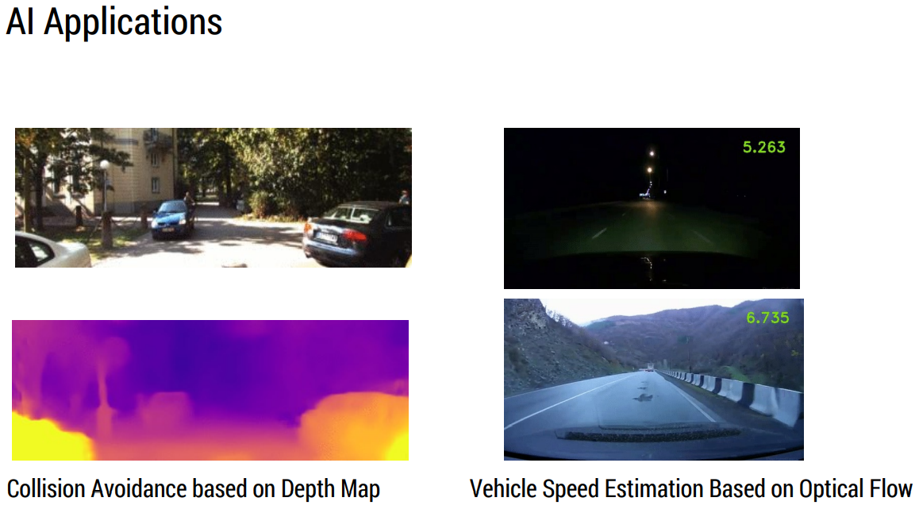

Slide 17
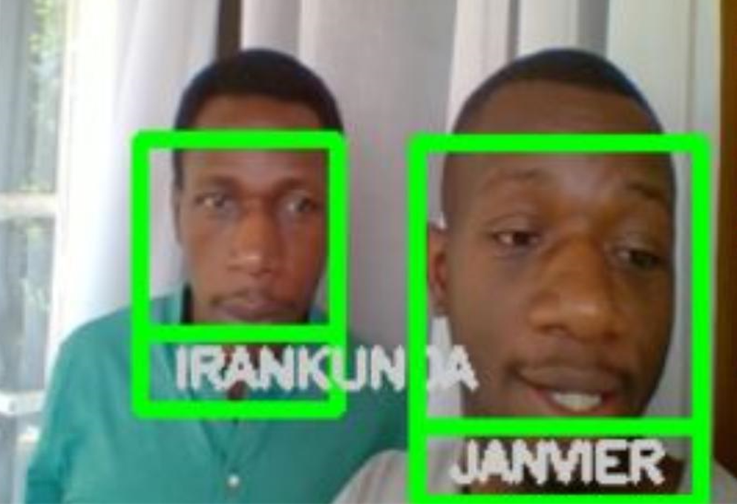
AI-Applications-Facial Tracking

Slide 18

Questions and Discussions
Thank you

